Slide 1

A Material Design Study App
Material study
R.VIJAYAKUMAR
K.SUBASH CHANDRA BOSE
M.ASHIKA
R.RAJASHWARI

Slide 2
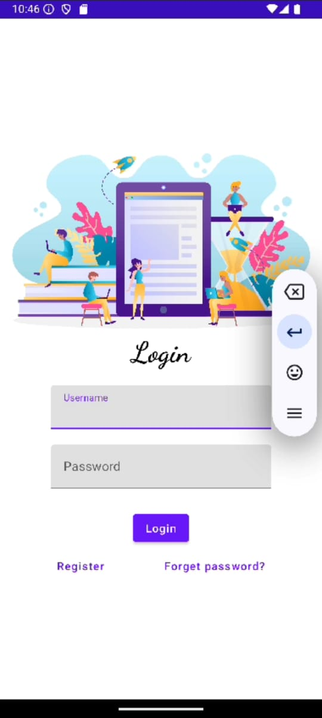
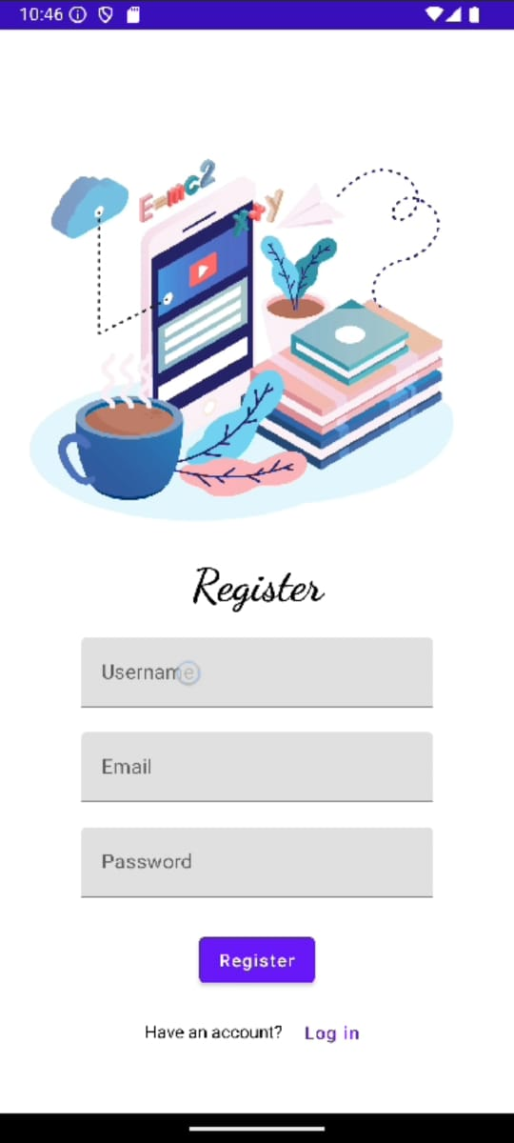
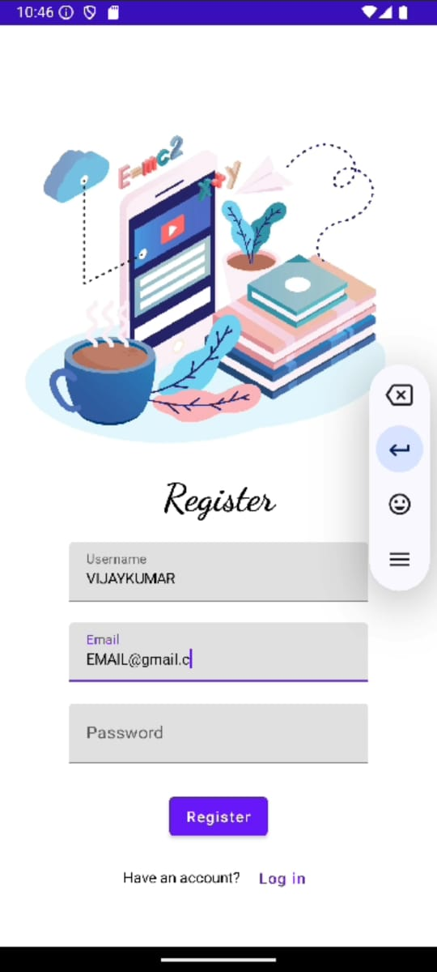
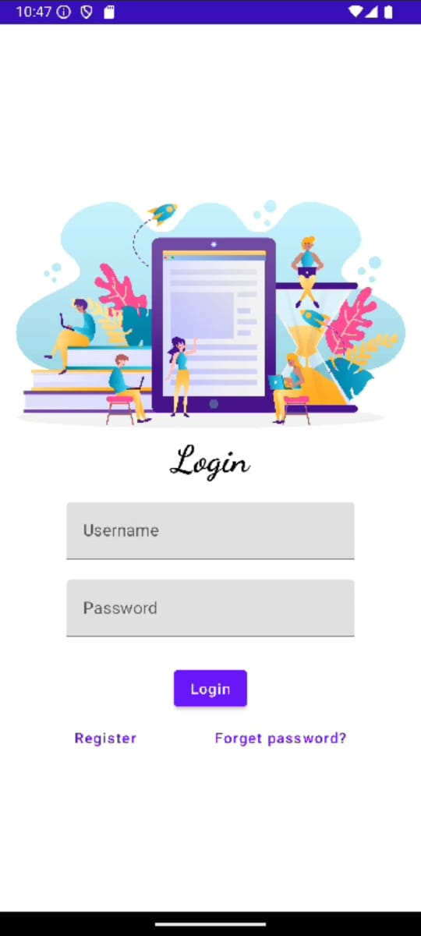
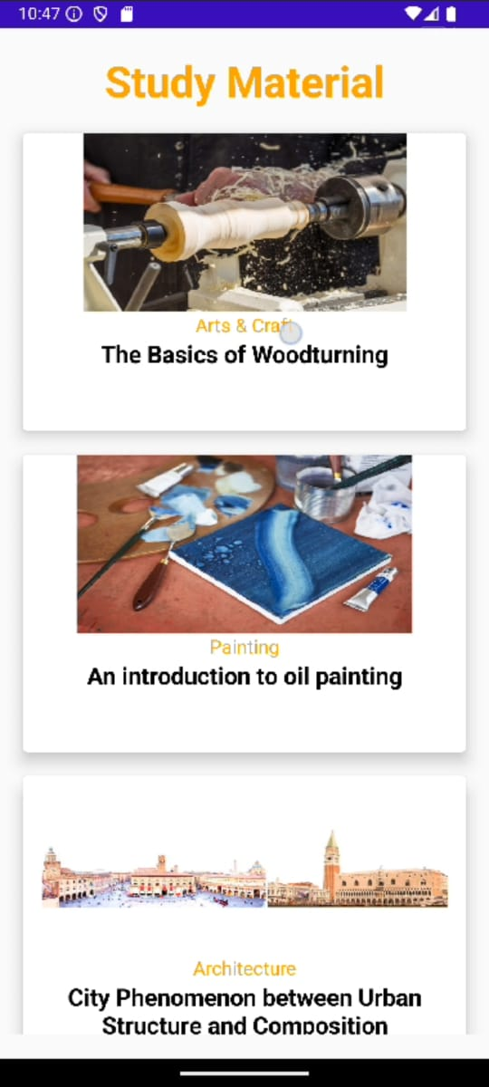
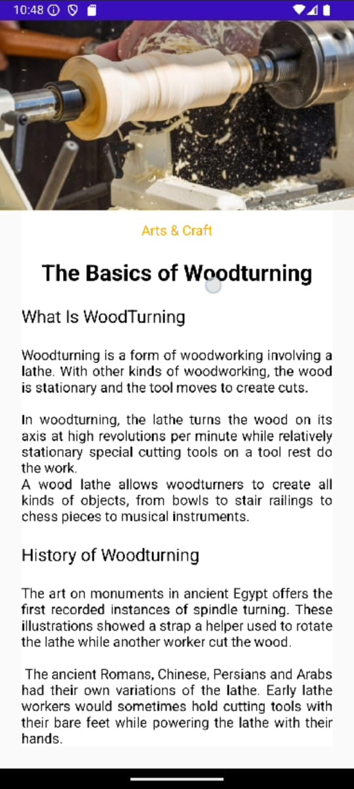

Slide 3
Overview:
Owl-M is an innovative and user-friendly study app designed to help students and professionals manage their learning tasks effectively. The app adopts Google's Material Design principles to provide an intuitive, visually appealing, and easy-to-navigate user interface. Owl-M focuses on making learning a structured and efficient process, offering features like task management, study scheduling, flashcards, notes, and more. It is designed to enhance the user's study experience through a sleek, modern interface while promoting focus and productivity.

Slide 4
Technology Stack:
Platform: Android (initial release), iOS (future expansion)
Programming Languages: Kotlin (Android), Swift (iOS)
Database: Firebase for cloud storage and synchronization
UI/UX Design: Figma (for prototyping and UI design)
Framework: Jetpack Compose (Android) for building Material Design-based UI
Additional Tools: Firebase Analytics, Google Drive API for cloud sync, and Spaced Repetition Algorithm for flashcards.

Slide 5
Development Roadmap:
Phase 1 - MVP (6 months):
Basic study task management
Flashcards system
Study scheduling and reminders
Note-taking functionality
Material Design UI implementation
Offline mode support

Slide 6
Development Roadmap:
Phase 2 - Feature Enhancement (3-6 months):
Progress tracker and analytics dashboard
Social sharing and community integration
Advanced study statistics and insights
Dark Mode
iOS version development

Slide 7
Development Roadmap:
Phase 3 - Growth & Expansion (ongoing):
Further integrations with other educational platforms (e.g., Google Classroom)
Collaborative study groups and peer reviews
Support for additional languages and localization
Expanded cloud synchronization options

Slide 8
Monetization Strategy:
Monetization Strategy:
Freemium Model:
  Basic features are free, with premium features such as advanced analytics, extra storage, and additional flashcard features available through a subscription.
In-App Purchases:
  Users can purchase additional study materials, specialized study plans, or access exclusive study groups.

Slide 9
MainActivity.kt
class LoginActivity : ComponentActivity() { private lateinit var databaseHelper: UserDatabaseHelper override fun onCreate(savedInstanceState: Bundle?) { super.onCreate(savedInstanceState) databaseHelper = UserDatabaseHelper(this) setContent { LoginScreen(this, databaseHelper) } } } @Composable fun LoginScreen(context: Context, databaseHelper: UserDatabaseHelper) { var username by remember { mutableStateOf("") } var password by remember { mutableStateOf("") } var error by remember { mutableStateOf("") } Column( modifier = Modifier.fillMaxSize().background(Color.White), horizontalAlignment = Alignment.CenterHorizontally, verticalArrangement = Arrangement.Center ) { Image(painterResource(id = R.drawable.study_login), contentDescription = "") Text( fontSize = 36.sp, fontWeight = FontWeight.ExtraBold, fontFamily = FontFamily.Cursive, text = "Login" )

Slide 10
Spacer(modifier = Modifier.height(10.dp)) TextField( value = username, onValueChange = { username = it }, label = { Text("Username") }, modifier = Modifier.padding(10.dp) .width(280.dp) ) TextField( value = password, onValueChange = { password = it }, label = { Text("Password") }, visualTransformation = PasswordVisualTransformation(), modifier = Modifier.padding(10.dp) .width(280.dp) ) if (error.isNotEmpty()) { Text( text = error, color = MaterialTheme.colors.error, modifier = Modifier.padding(vertical = 16.dp) ) } Button( onClick = { if (username.isNotEmpty() && password.isNotEmpty()) { val user = databaseHelper.getUserByUsername(username) if (user != null && user.password == password) { error = "Successfully log in" context.startActivity( Intent( context, MainActivity::class.java ) ) //onLoginSuccess() } else { error = "Invalid username or password" } } else { error = "Please fill all fields" } }, modifier = Modifier.padding(top = 16.dp) ) { Text(text = "Login") }

Slide 11
Column(
modifier = Modifier.fillMaxSize().background(Color.White),
horizontalAlignment = Alignment.CenterHorizontally,
verticalArrangement = Arrangement.Center
) {
Image(painterResource(id = R.drawable.study_login), contentDescription = "")
Text(
fontSize = 36.sp,
fontWeight = FontWeight.ExtraBold,
fontFamily = FontFamily.Cursive,
text = "Login"
)
Spacer(modifier = Modifier.height(10.dp))
TextField(
value = username,
onValueChange = { username = it },
label = { Text("Username") },
modifier = Modifier.padding(10.dp)
.width(280.dp)

Slide 12
Text(text = stringResource(id = R.string.course4),color = Color(0xFFFFA500),
fontSize = 16.sp)
Text(
text = stringResource(id = R.string.topic4),
fontWeight = FontWeight.Bold,
fontSize = 20.sp,
textAlign = TextAlign.Center,
)
}
}
}
}

Slide 13


